Slide 1
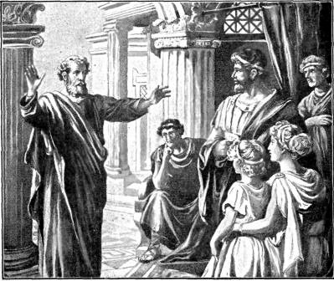
The Preacher and the Penitent
Acts 10

Slide 2
The Preacher (9-16; 27-29; 11:17) The Penitent (10:1-8, 24-26, 30-33) The Message (34-43) The Result (44-48)
The Conversion
of
Cornelius

